Slide 1
Uniforum
ERD and Class Diagram Presentation
Group 1(A2)[1805018, 1805031, 1805043, 1805044, 1805059, 1805060]
Presented by: Arup Debnath[1805043]
Md. Shamim Al Mamun[1805060]

Slide 2
Class Diagram

Slide 3
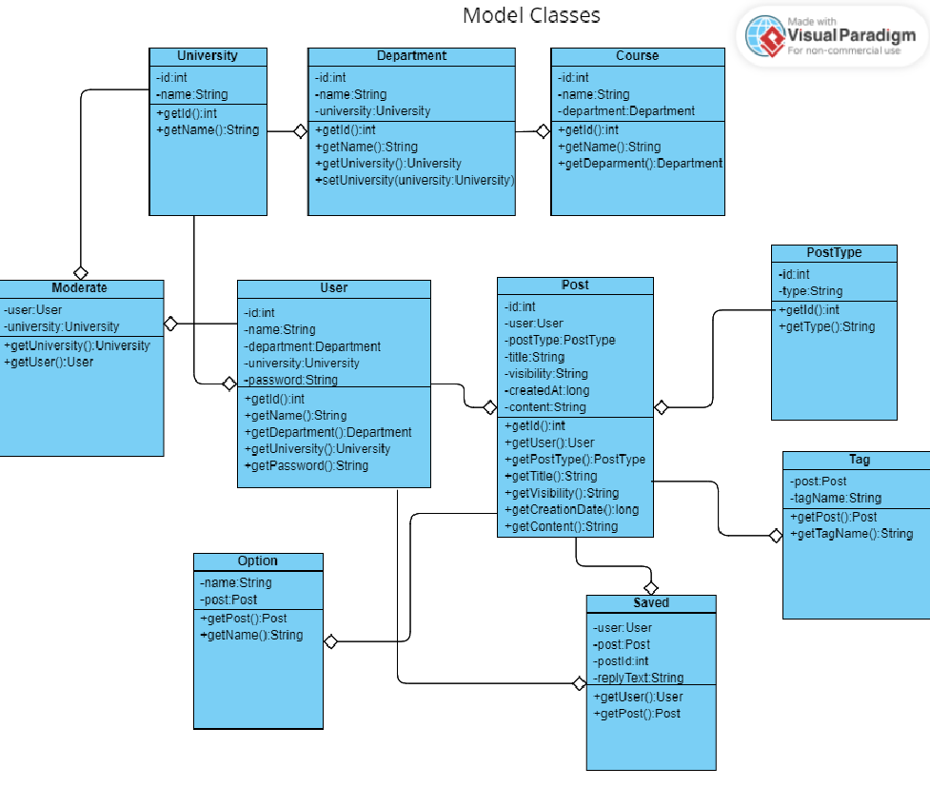

Slide 4
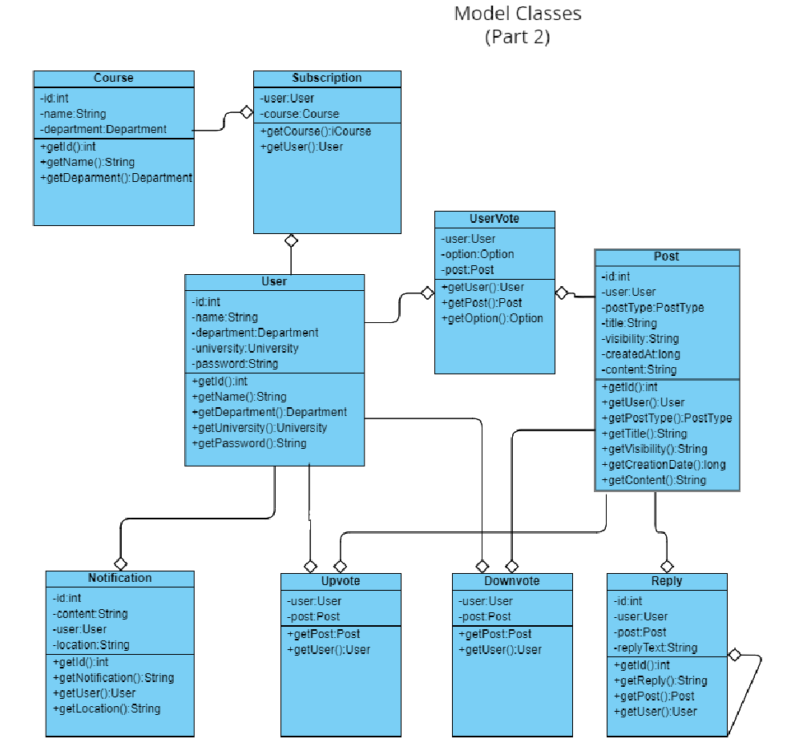

Slide 5
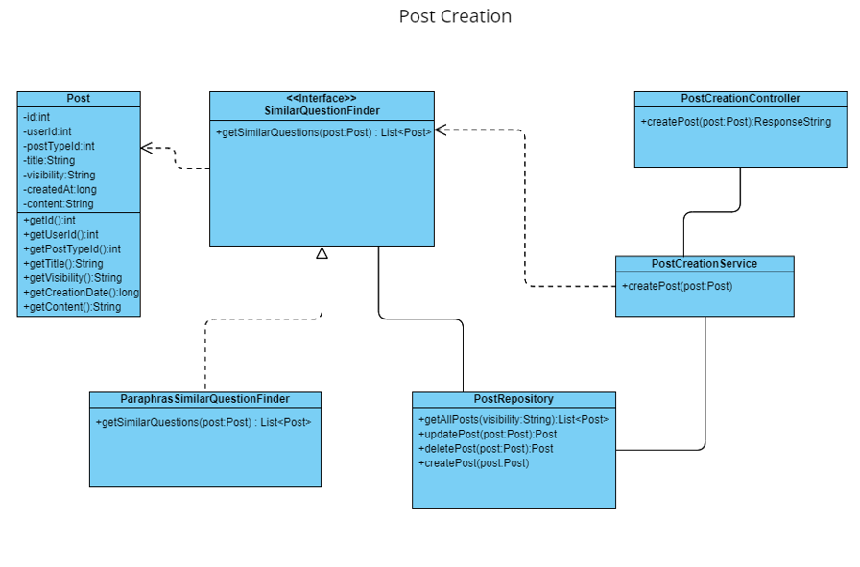

Slide 6
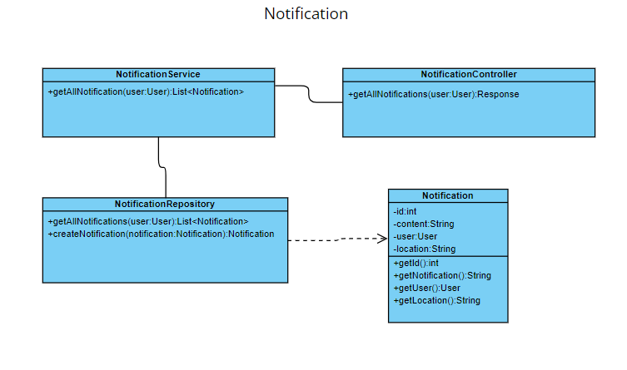

Slide 7
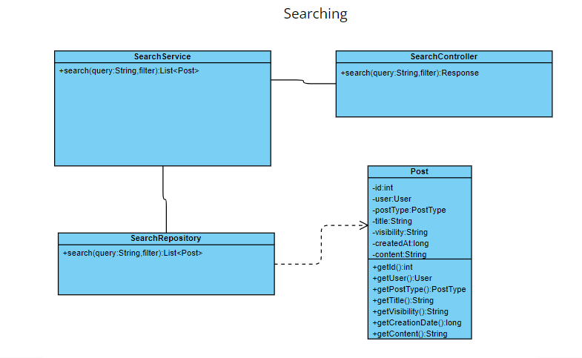

Slide 8
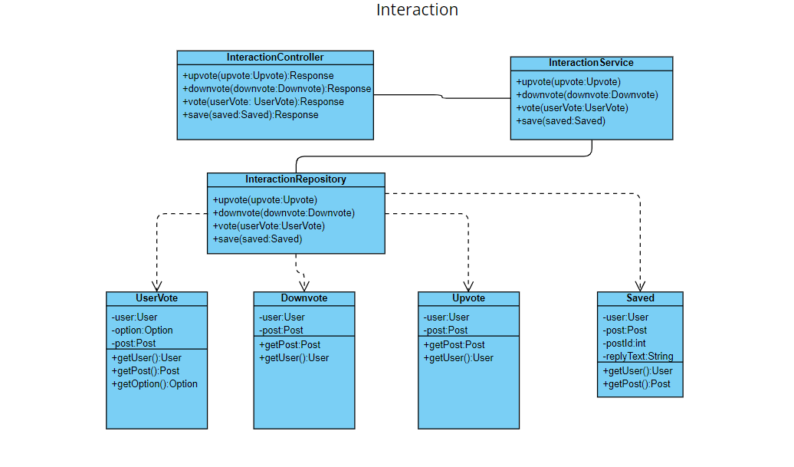

Slide 9
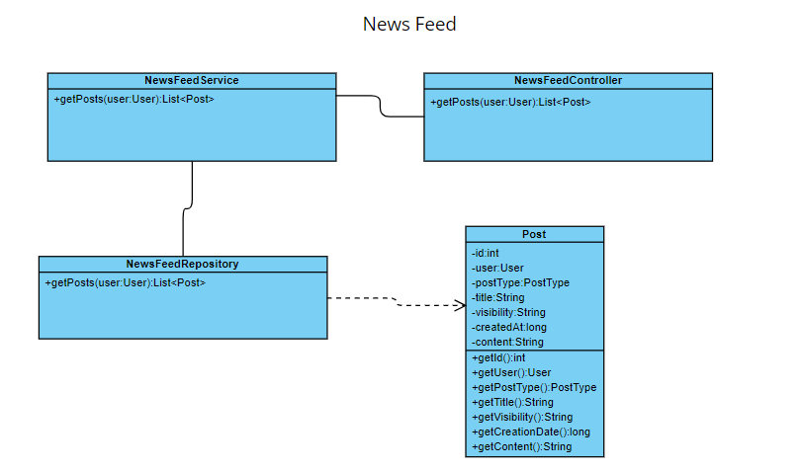

Slide 10
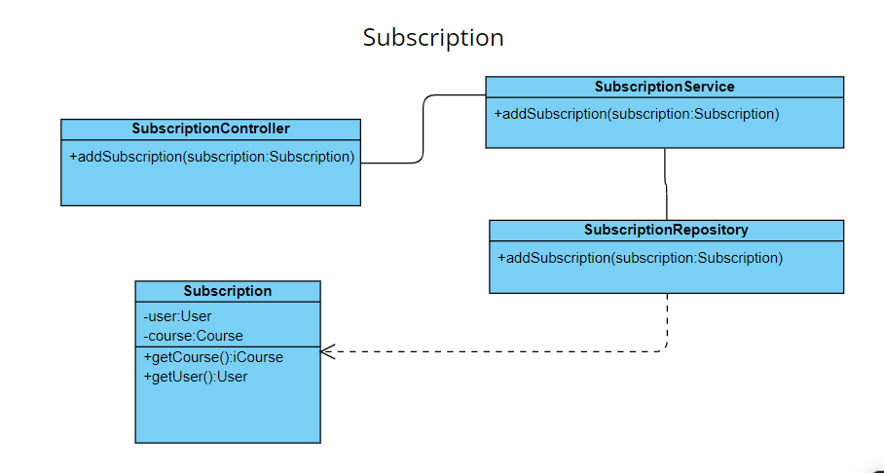

Slide 11
ERD

Slide 12
